Slide 1

: BE-Project –I (01.09.21) Evaluation –PPT-Presentation
Title of Project :- FPGA Based Blind Assistance System Domain :- Electronic Ckt & System Design(ECSD) Category:-
Group No - 01 Name of Guide : Dr. Sandhya Save
Name of Student:
(1) Omkar Nandan Choudhary (06)
(2) Ishaan Anand Shinde (38)
(3) Arun Kumar Singh (40)

Slide 2
Problem Objective and Motivation
Around 62 million people in India are visually impaired, for them performing even basic daily tasks is a challenge. The aim of this project is to design a system that provides them a means of navigation and assistance.

Slide 3
Problem Definition
Developing a means of micro-navigation which is able to provide haptic feedback to the user. It needs to have low latency, this ensures safety of the user and it provides ample time to react to incoming obstacles. It should have a mechanism for tactile feedback indicating to the user location of the obstacles.

Slide 4
Problem Statement and Solution
Visually impaired face many hindrances in performing daily tasks, this project aims to help them navigate unknown environment with ease. This project is focused on detecting obstacles with a radius of 5-7 meters. To implement this sensors will be integrated to a FPGA board to detect any obstacles in the surrounding and these details will be relayed back to the user using tactile feedback.

Slide 5
Literature Survey - 1
sr no. | Title | Author | Conference | Year of Publishing | Contribution of the Paper | Remark
1 | Smart Cane for Blind and Visually Impaired Persons | Alex Y, Shilpa Shyam | International Journal of Creative Research Thoughts (IJCRT) | May, 2020 | *The proposed work includes the design of a smart cane with multiple sensors connected to an Arduino board. *ultrasonic and infrared sensors are mounted at appropriate locations to detect obstacles. *A buzzer, vibrator and some recorded audio clips to navigate the blind people safely. | *A detailed Study on the design of a smart cane, considering the average body dimensions. *Mounting of the sensors to get the optimum data. *Elements like buzzers, speakers and vibration motors that can be used to alert the user effectively.
2 | Design and Implementation of Mobility Aid for Blind People | B.S. Sourab, Ranganatha Chakravarthy H.S, Sachith D’Souza | 2015 International Conference on Power and Advanced Control Engineering (ICPACE) | August, 2015 | *Draws attention to the shortcomings of already existing solutions. *The proposed solution is a Jacket which has to be worn by the visually Impaired. *The Jacket is mounted with a collection of ultrasonic Sensors to provide assistance to the user. | *The proposition consists of a collection of ultrasonic sensors to assist the user in estimating the distance between an obstacle and the user. *The solution suggests addition of earphones, substituting bigger speakers, to effectively alert the user.

Slide 6
Literature Survey - 2
Design of a FPGA based Virtual Eye for the Blind | V.Dhilip Kanna,ECE, P.V.Deepak Govind Prasad | 2nd International Conference on Environmental Science and Technology IPCBEE vol.6 | 2011 | This project was implemented usign a LiDAR and PID sensor placed on the users body. Each frame is comapred to the previosu frame and location data of the user as well as changes in the surrounding is noted.
A Stereo Vision System for Pedestrian Navigation | Franjo Cecelja, Wamadeva Balachandran, Rommanee Jirawimut | 17 International Conference on Applied Electromagnetics and Communications | 2003 | In this paper the project was implemeted using Stereo cameras. For accurate motion estimation Gait analysis and ego-motion estimation algorithm is used.
A system for remote sighted guidance of visually impaired pedestrians | V. Garaj, R. Jirawimut, P. Ptasinski, F. Cecelja and W. Balachandran | British Journal of Visual Impairment | 2003 | In this paper the authors designed the guidance system using GPS as the main navigation device. As shown in the paper the accuracy of this approach is not sufficient enough for users to be able to traverse a unknown path with ease. This is especially true in cases where obstacles are blocking the GPS signal. They have also proposed to use cameras to supplement the GPS device.
Navigation Assistance for the Visually Impaired Using RGB-D Sensor With Range Expansion | A. Aladrén, G. López-Nicolás, Member, IEEE, Luis Puig, and Josechu J. Guerrero | IEEE | 2014 | *The proposed work includes the design of a wearable camera connected to an laptop and headphone. *A buzzer, vibrator and some recorded audio clips to navigate the blind people safely. A detailed Study of algorithms of a NAVI using RGB-D sensor.

Slide 7
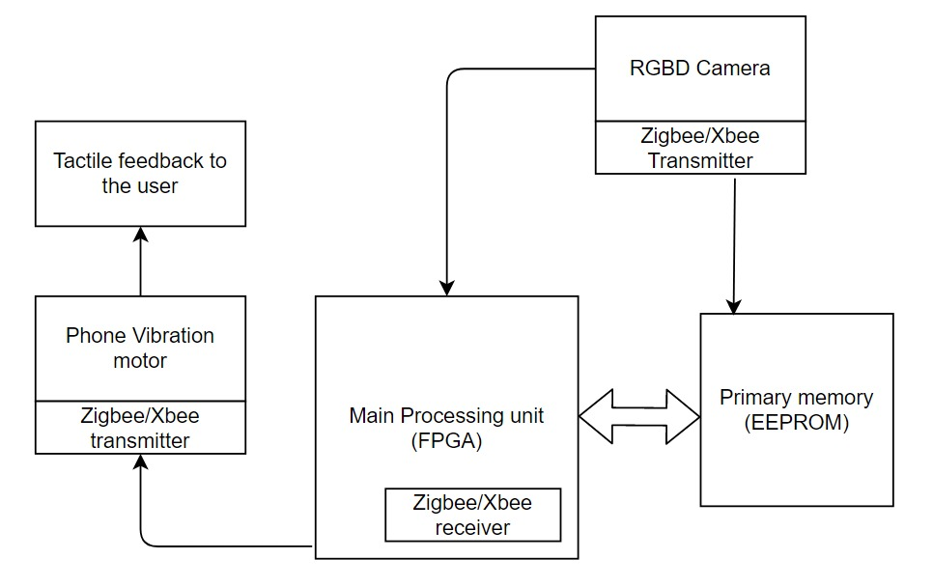
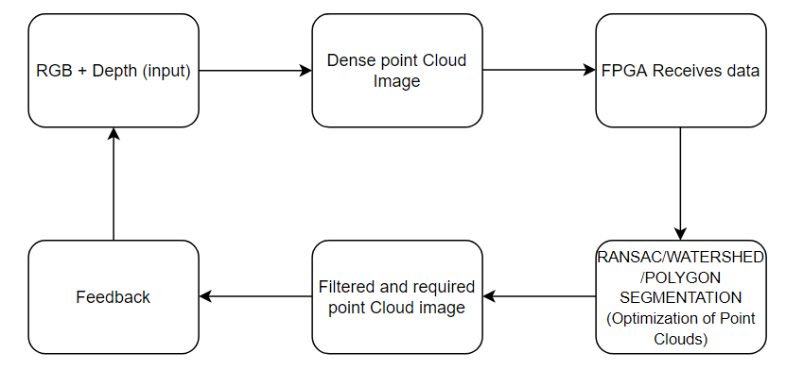
Block Diagram and Project Workflow
Fig1. Block Diagram
Fig2. RGBD Camera Workflow

Slide 8
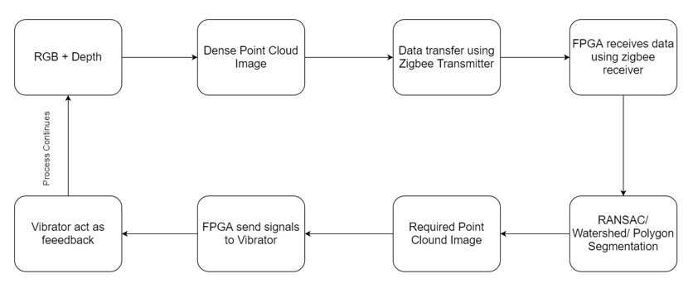
Block Diagram and Project Workflow (continuation)
Fig2. Project Workflow

Slide 9
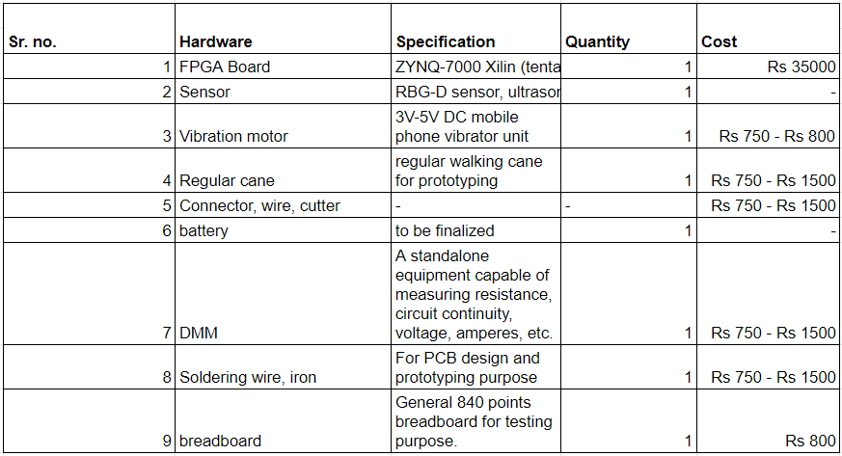
Hardware Tools
Hardware Component List (tentative)

Slide 10
Software Tools
Sr. no | Software Application | Specification | Cost
1 | Xilinx Software Development Kit (XSDK) | The Software Development Kit (SDK) is the Xilinx Integrated Design Environment for creating embedded applications on any microprocessors for Zynq®-7000 SoCs
2 | Matlab | MATLAB is a proprietary multi-paradigm programming language and numeric computing environment | Student trial version available
List of Software platforms to be used

Slide 11
Project Application
This project is focused on assisting a Visually Imapired individual in navigating their immediate surrounding. It will be able to detect stationary and moving objects and inform about these to the user using haptic feedback. This system will be embedded in cane. The handle of the cane will act as the user interface. The design of the cane will be such that it feels familiar to the cane the user is already used to.

Slide 12
References
FPGA Design course on Coursera: https://www.coursera.org/learn/intro-fpga-design-embedded-systems
Intel fpga board: https://www.intel.com/content/www/us/en/products/details/fpga/find-fpga-boards.html#sort=%40title%20ascending
IEEE XPLORE (literature Survey):
https://ieeexplore.ieee.org/Xplore/home.jsp
Design Recipes for FPGAs, Peter Wilson
Introduction to Embedded System Design Using Field Programmable Gate Arrays, Rahul Dubey
Embedded Systems Design with FPGAs, Peter Athanas, Dionisios Pnevmatikatos, Nicolas Sklavos

Slide 13
Information of Students
Omkar Nandan Choudhary
Tel: +91 7875336344
Email: omknan60@gmail.com
Address:
23/A, Vrindavan 2, Naigaon (EAST)
Ishaan Anand Shinde
Tel: +91 9664859323
Email: ishaan.shnd@gmail.com
Address:
1/A-802, Suncity ph-1, Thakur Village, Kandivali (East), Mumbai 400101
Arun Kumar Singh
Tel: +91 8369388277
Email: arunks2902@gmail.com
Address:
A/302 Abhishek apt, Shanti Park, Mira Road(East), Thane- 401107

